Slide 1
HISTORY OF INFORMATION TECHNOLOGY
Information Technology in Business and Society I

Slide 2
History of Information Technology
There are 4 main eras in the history of IT:
The Premechanical Age: 3000 BC and 1450 AD
The Mechanical Age: 1450 – 1840
The Electromechanical Age: 1840 - 1940.
The Electronic Age: 1940 - Present.

Slide 3
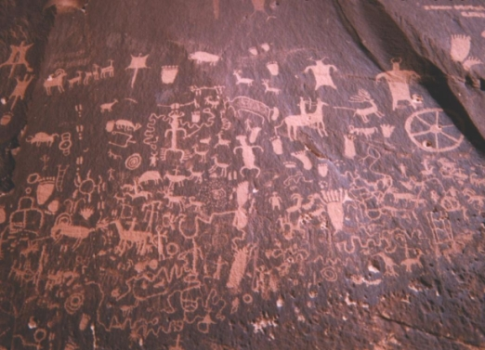
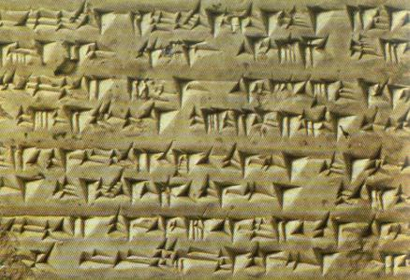
1. The Premechnical Age
It is the earliest age of information technology.
Between the years 3000 BC and 1450 AD
Its first form: Writing and Alphabets
Cuneiform (around 3000 BC), then symbols (around 2000 BC).

Slide 4
1. The Premechnical Age
Papers and Pens
Sumerians, Egyptians, Chinese
Books and Libraries
The first numbering system is also discovered in this age.
Egyptians and Hindus in India used the numbering system.

Slide 5
1. The Premechnical Age
The numbering system similar to those we use today is invented between 100 and 200 AD.
The invention of zero comes much later.

Slide 6
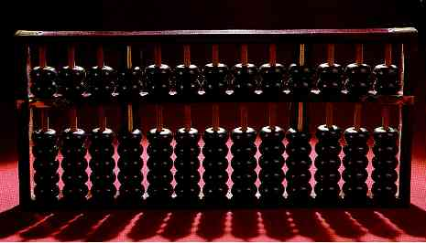
1. The Premechnical Age
The first calculator is also discovered during this age.

Slide 7
2. The Mechanical Age: 1450 – 1840
This is the age that we observe the first connections between the technology of today and its ancestors.
Slide rule is invented (early example of analog computers).
The first general purpose computers are developed.
"computer: one who works with numbers."

Slide 8
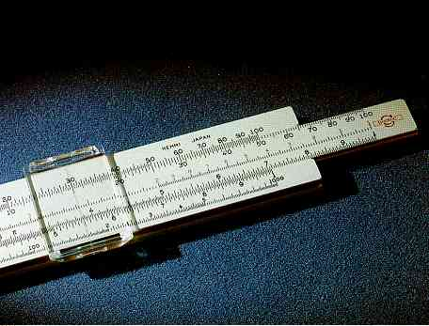
2. The Mechanical Age: 1450 – 1840
Slide rule.
An analog computer used for multiplying and dividing.

Slide 9
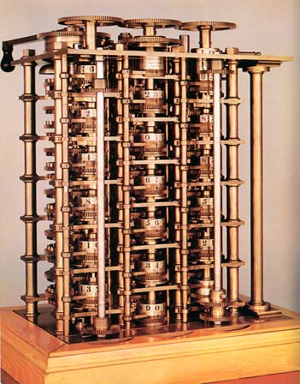
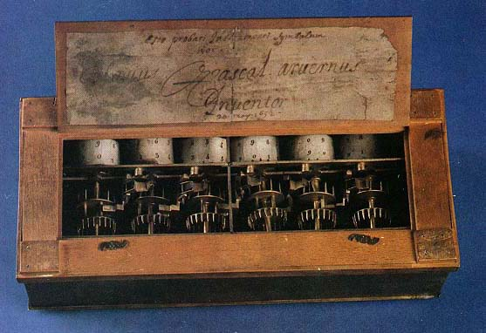
2. The Mechanical Age: 1450 – 1840
Blaise Pascal invented the Pascaline machine.
Difference engine is invented by Charles Babbage.
Ada Lovelace is the first programmer.

Slide 10
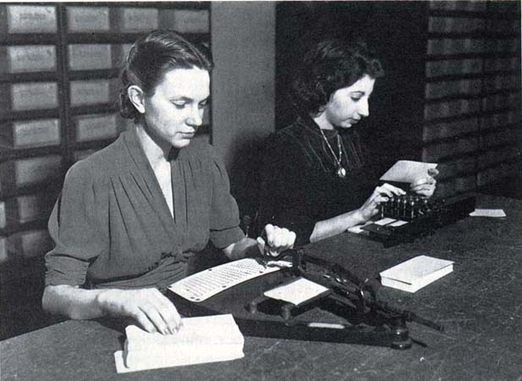
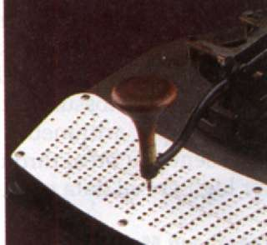
2. The Mechanical Age: 1450 – 1840
Punch cards is the another development in this era.
Introduced in 1801
Binary logic
Fixed program operating in real time.

Slide 11
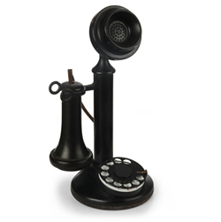
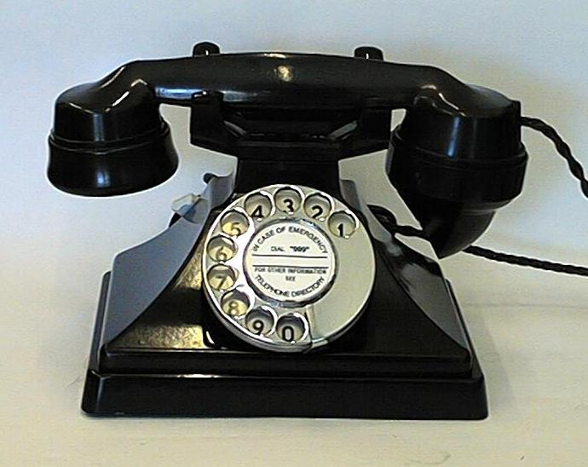
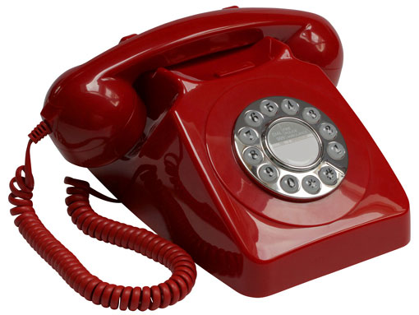
3. The Electromechanical Age: 1840 - 1940. - Communication
The most important advance in this era is to use electricity.
The developments in this age are the beginnings of communication.
Telegraph (early 1800s), radio
Morse Code
Telephone (examples in 1876, 1930, 1970 respectively).

Slide 12
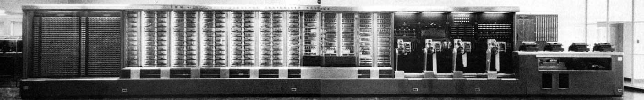
3. Electromechanical Computing
The International Business Machines Corporation (IBM). Mark I around 1940
Programmed by using punch cards (no storing)

Slide 13
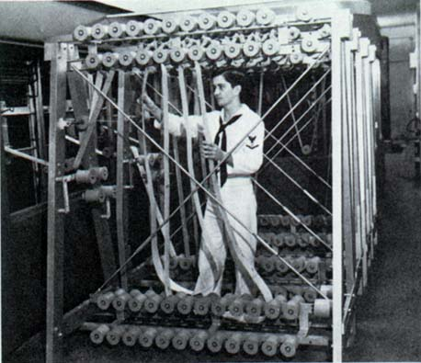
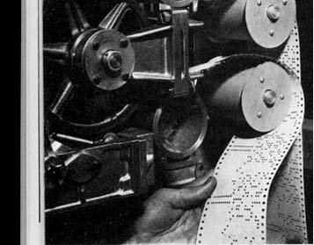
Mark I -1942 (for the WW II)

Slide 14
4. The Electronic Age: 1940. – present
That is the age that we are currently living in.
ENIAC – the first high-speed, digital computer capable of being reprogrammed to solve a full range of computing problems.
Used vacuum tubes – no mechanical devices.
No storage of programs.
The first stored program computer(s): The University of Manchester Mark I and The EDSAC in Cambridge in 1949.
The First General-Purpose Computer for Commercial Use: Universal Automatic Computer (UNIVAC)

Slide 15
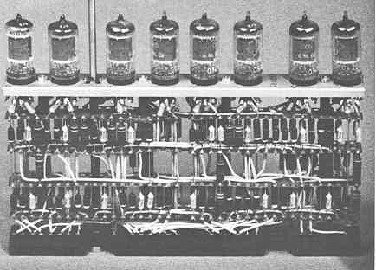
The Four Generations of Digital Computing:
1. The First Generation (1951 – 1958)
Vacuum Tubes and punch cards – used in ENIAC and Mark I

Slide 16
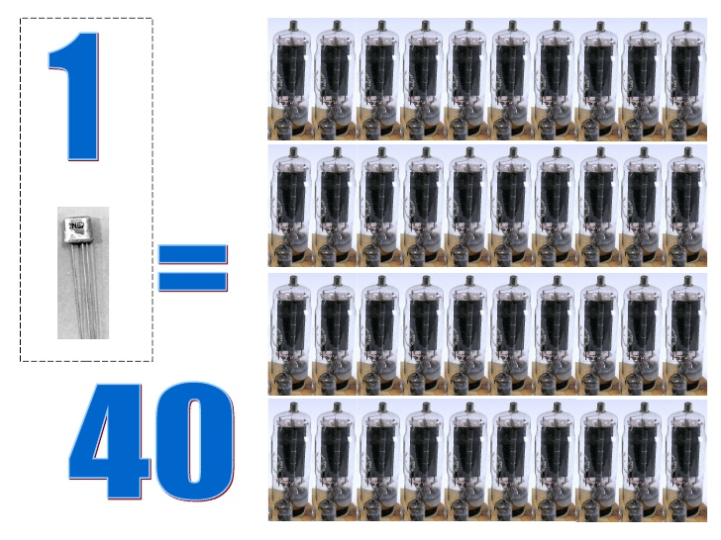
Second Generation (1959 -1963)
From Vacuum Tubes to Transistors
Punch Cards to Magnetic Tapes

Slide 17
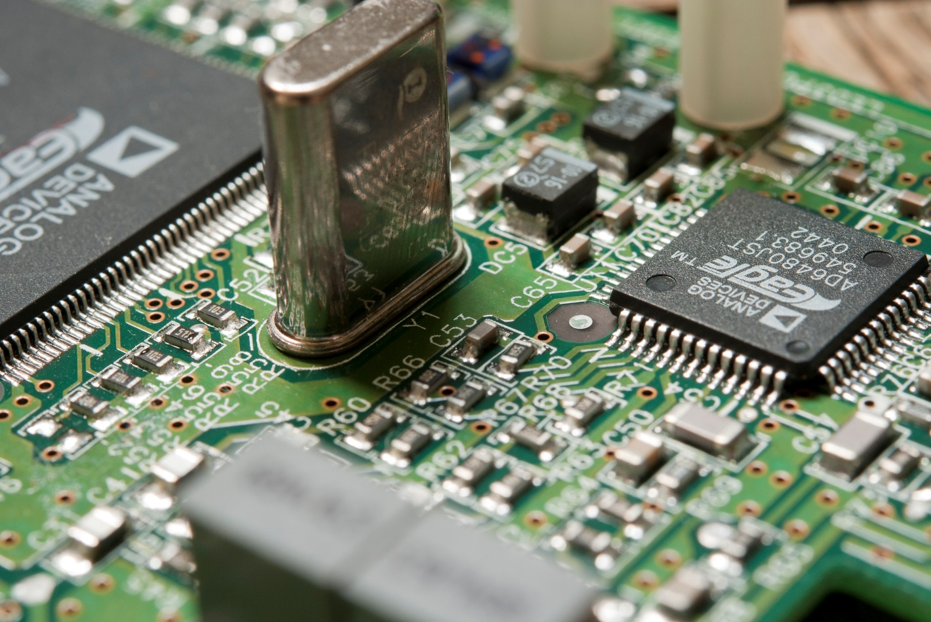
Third Generation (1964 -1979) Integrated Circuits

Slide 18
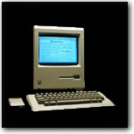
Fourth Generation (1979 – present)
Apple’s first Mac with Graphical User Interface (GUI)

Slide 19
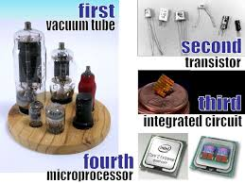
The four generations of digital computing

Slide 20
References
Laudon K. And J. Laudon, Management Information Systems Managing the Digital Firm, 12th Ed., Pearson Prentice Hall, 2012.
Baltzan, P., Business Driven Information Systems, 4th. Ed., McGraw Hill, 2014.
Valacich, J and C. Schneider, Information Systems Today Managing in the Digital World, 5th Ed., Prentice Hall, 2012.

